Slide 1
EVENT ATTENDANCE

Slide 2
Description:
An application where a student can select an event from a list of upcoming events and put up a request for attendance for the same which first would be sent to class teacher which after evaluation(based on student’s profile) would be approved and sent to HOD for permission. Once HOD approves an automatic sms should be generated to that students subject teacher to mark his/her attendance.

Slide 3
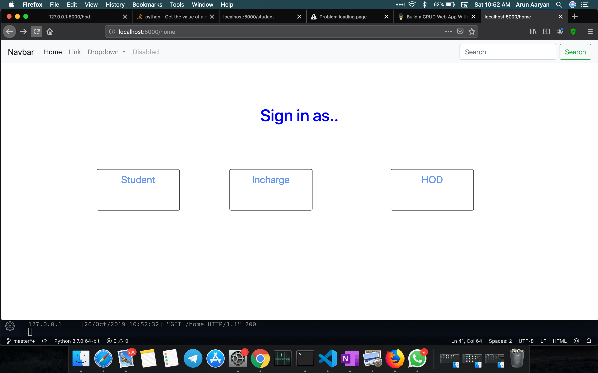
Login based on profile

Slide 4
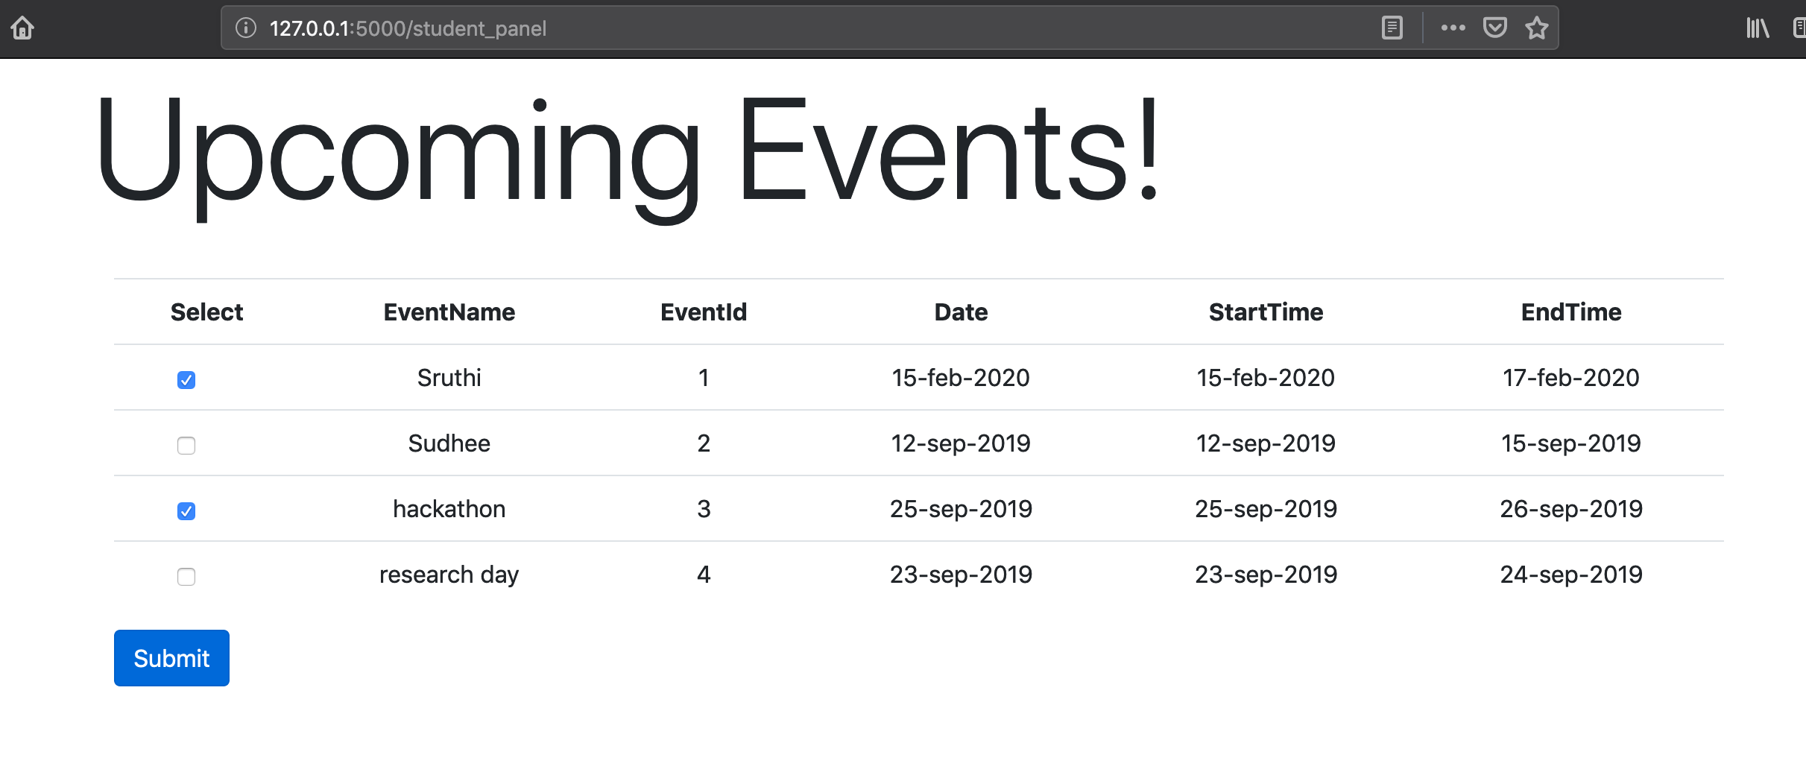
List of events

Slide 5
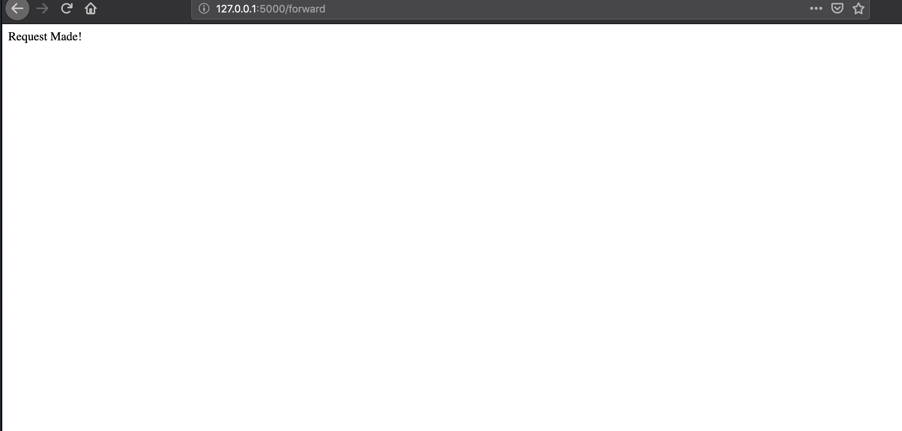
Request for attendance

Slide 6
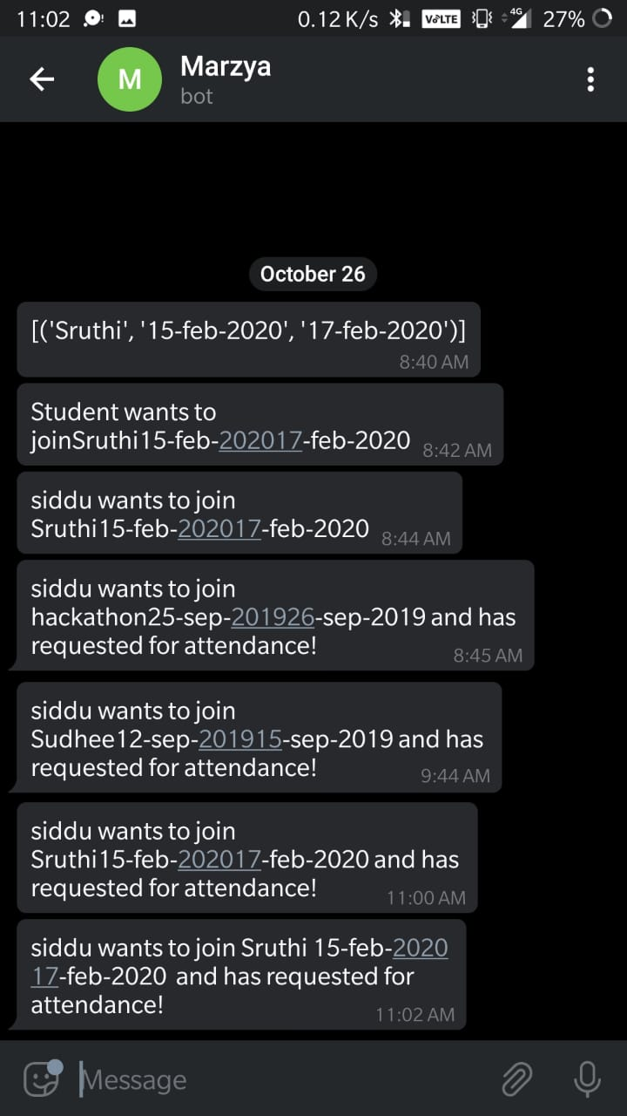
Request sent to class teacher

